Slide 1
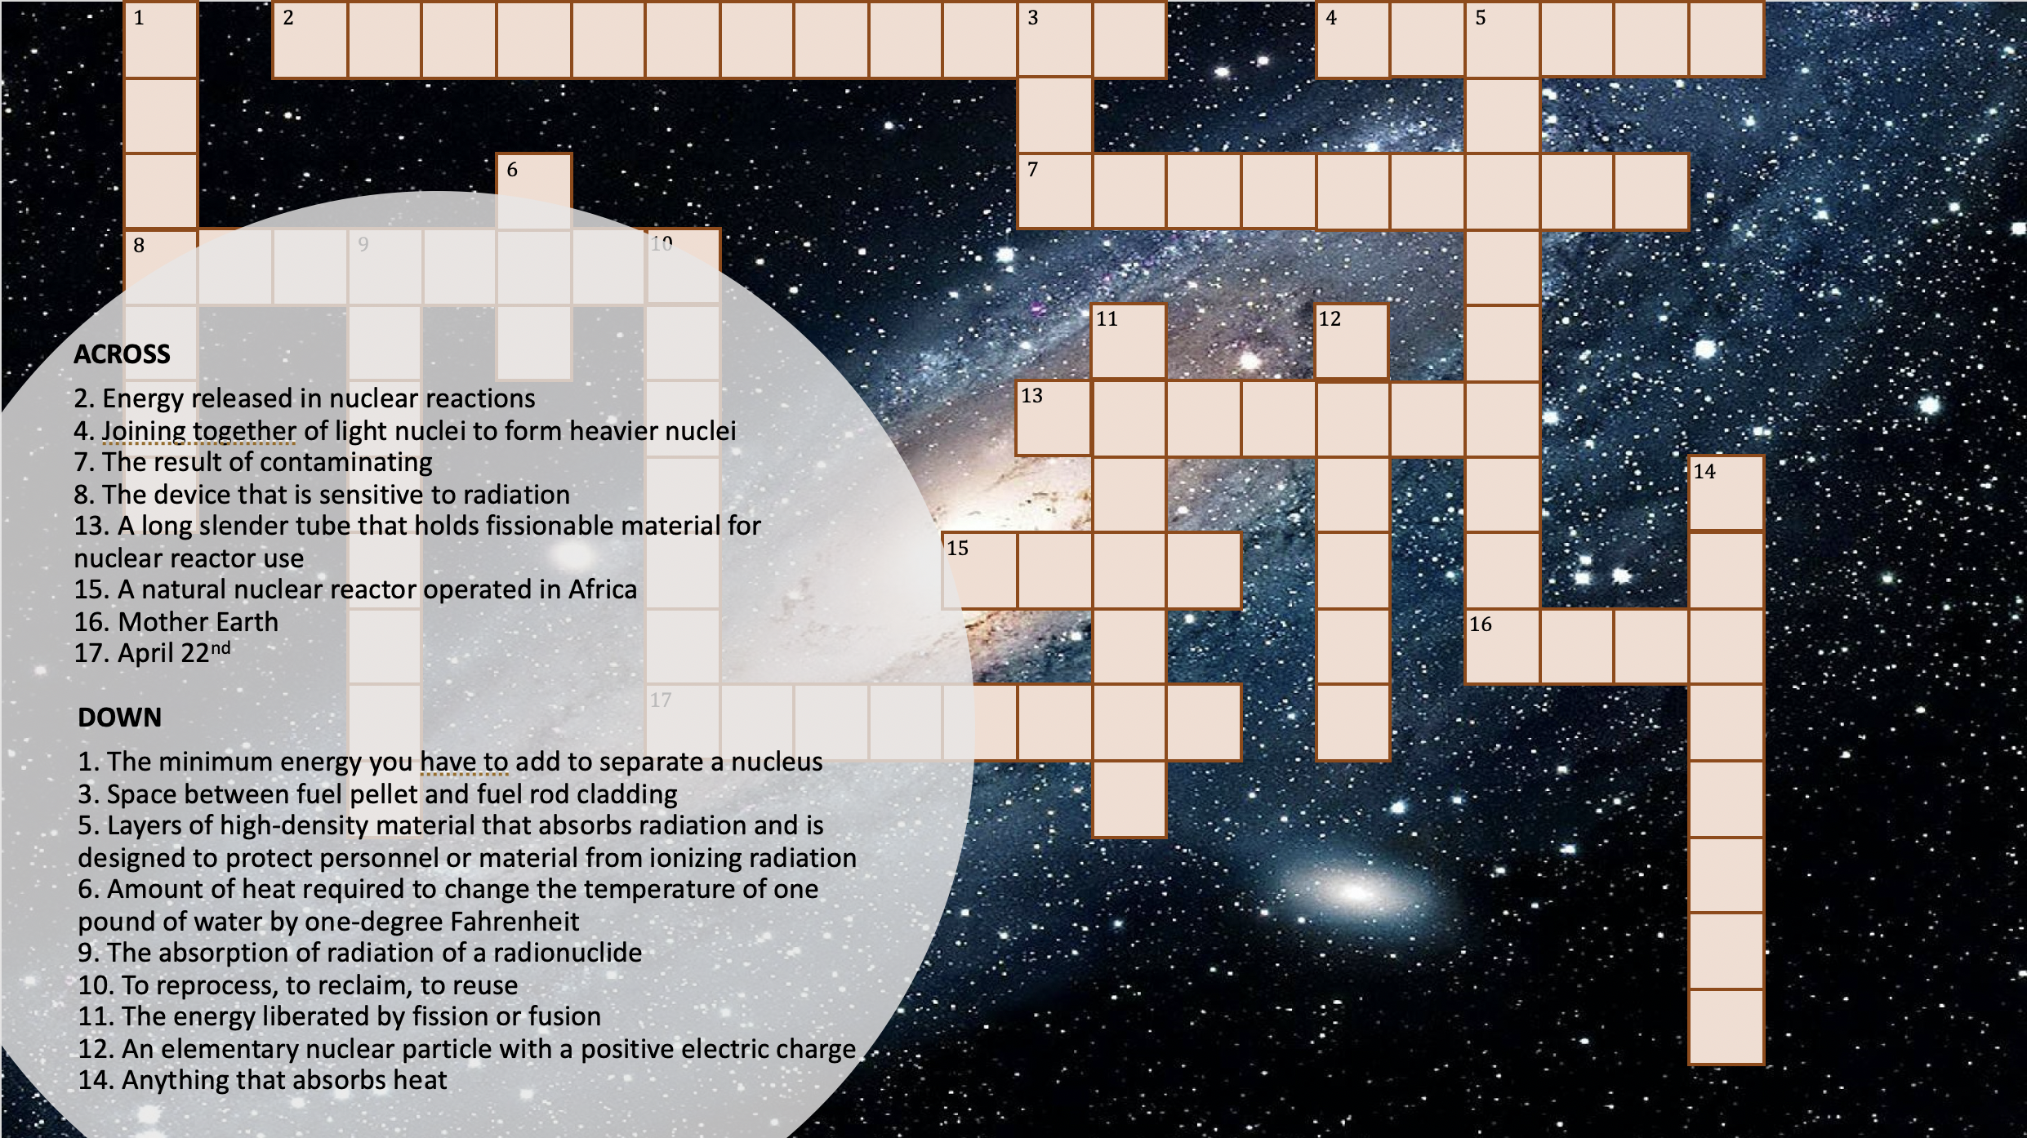
Crossword Puzzle
PowerPoint Game
A template for designing in PowerPoint
your own Educational Crossword Puzzles
(Version 1.0)
Puzzle clues adapted from http://nuclearconnect.org/nst/nst_answer.php
By Prof. Joe Bisz
www.joebisz.com

Slide 2
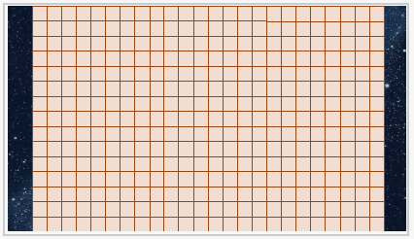
What You Can Teach:
Crossword games are typically used with quiz questions. Since they are based on cut-ups, they can also teach any linear concept (e.g. equations, or even image scrambles like a jigsaw puzzle).
Therefore, you will want to replace the sample questions and answers in this crossword template with your own. (This file can be used and remixed for most purposes; see details under the Creative Commons license Attribution 4.0 International.)
How to “Cross” Your “Words”:
Once you have your questions and answers, it can be quite a “puzzle” for the teacher-designer to figure out how to lay out all the answers in a crossword! Don’t worry, there is software for that. Try a free “crossword puzzle maker” such as https://tools.atozteacherstuff.com/free-printable-crossword-puzzle-maker. Keep in mind that you’ll have to make adjustments to what questions and answers you include, since not all of them will magically align in a crossword. If you’re using my template here, it also cannot exceed 24 square wide x 15 squares high.

Slide 3
Add Your Answers to Crossword Template:
Once you have a finished layout for your crossword answers, it’s time to make the interactive game! Go to the slide that looks like the image on the right. Carefully type one letter per square until your whole crossword is finished. Then delete each square you don’t need to reveal the background image and create a blank area. Yes, this will take a long time, but then, it’s finished…

Slide 4
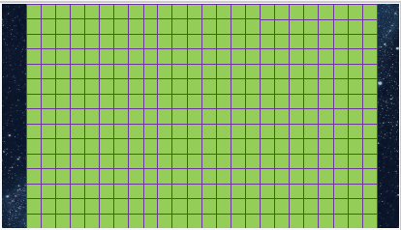
Change Theme (Color of Squares and Background Image):
Since it’s your game, if you have the time, you should customize the images and colors to something you like. To change the square colors, Select All, then pick Shape Fill (or Shape Outline to change the border line colors). To change the background image, select Format > Slide Background. On the right, you’ll see an example where I changed my pink squares to green and their border lines to purple. Be sure to keep your shape fill a light color so students can see the letters they type in.
Also, you may want to change the transparency of your background so that your image doesn’t make it hard to see your squares. For example, you’ll notice my background solar system image is more transparent on my slide with the empty crossword than on my slide with the questions. (Yep, it took a designer to point that out to me…)

Slide 5
Create Questions Slide:
Put your questions on your own slide, so students can see the whole crossword by itself.
Optional Slide: You will notice I do have one slide with both questions and the empty crossword. That’s because I was using this as a cover image for the game. Then it occurred to me that students might find it useful to look at such a “combined” slide when they’re deciding which question to answer and how it would look like on the board. When they’ve decided, then can then change the slide to the one that has only the empty puzzle, where they add their answers. I’m not sure if this is more useful for them, but it shouldn’t be too hard to create the option.
Create Reference Slide:
In addition, you will need an extra copy of your “empty puzzle” slide to serve as a reference in case the students accidentally delete squares from the puzzle they’re solving, and they need to see how the whole structure is supposed to look. If you decided to create the optional slide ”with both questions and empty crossword,” it can also serve as the reference slide.

Slide 6
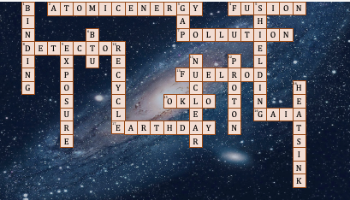

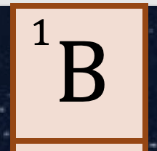
Number Your Rows and Columns:
This is a little tricky to do. I suggest copying the entire square that contains a number from my template, and pasting it directly over the matching square on your game. You could instead copy and paste my tiny text box that contains the number (rather than the whole square), but this is a little harder.

Slide 7
Decide if You Want More Points for Hard Questions:
Normally one measures a crossword’s success by how many questions one got right (e.g. 18/24, which is a kind of “score,” like on a quiz). But as the video explains, you can also encourage students to aim for (or avoid) harder questions that are worth more points. If you go this route, choose 2 or 3 levels of points—more than that is confusing and not needed. You’ll see that I have a version of the empty crossword slide with the colored stars (on right), and a version of the questions slide with the colored stars. Questions with orange stars are worth 3 points, questions with purple stars are worth 2 points, and all other questions are worth 1 point. Trying to “hit” a word with a star adds a lovely gaminess, like hitting the “Double Word” and triple Word” spaces in Scrabble.
That’s it—you’re finished! Time to play the game. But note you cannot play the games in Full-screen view; only Normal.

Slide 8
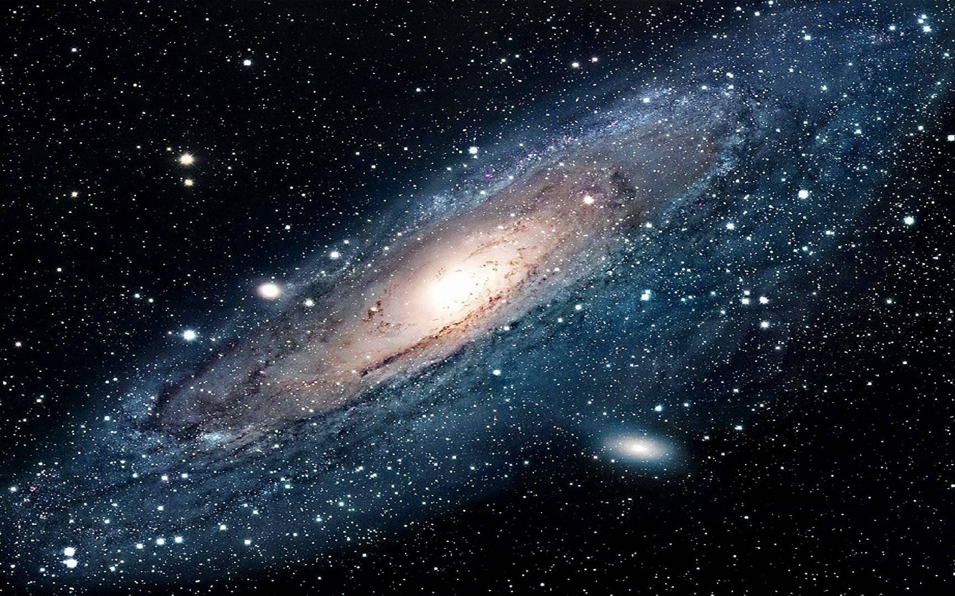
ACROSS
2. Energy released in nuclear reactions
4. Joining together of light nuclei to form heavier nuclei
7. The result of contaminating
8. The device that is sensitive to radiation
13. A long slender tube that holds fissionable material for nuclear reactor use
15. A natural nuclear reactor operated in Africa
16. Mother Earth
17. April 22nd
DOWN
1. The minimum energy you have to add to separate a nucleus
3. Space between fuel pellet and fuel rod cladding
5. Layers of high-density material that absorbs radiation and is designed to protect personnel or material from ionizing radiation
6. Amount of heat required to change the temperature of one pound of water by one-degree Fahrenheit
9. The absorption of radiation of a radionuclide
10. To reprocess, to reclaim, to reuse
11. The energy liberated by fission or fusion
12. An elementary nuclear particle with a positive electric charge
14. Anything that absorbs heat
Puzzle clues adapted from http://nuclearconnect.org/nst/nst_answer.php

Slide 9
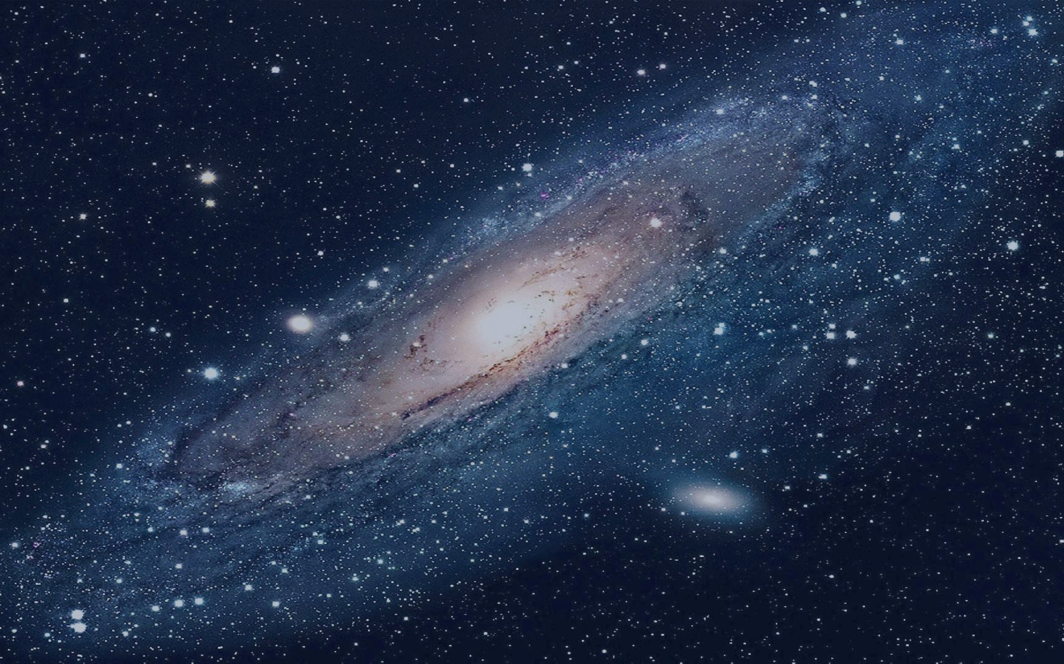
1
2
3
4
5
6
7
8
9
10
11
12
13
14
15
16
17

Slide 10
1
2
3
4
5
6
7
8
9
10
ACROSS
2. Energy released in nuclear reactions
4. Joining together of light nuclei to form heavier nuclei
7. The result of contaminating
8. The device that is sensitive to radiation
13. A long slender tube that holds fissionable material for nuclear reactor use
15. A natural nuclear reactor operated in Africa
16. Mother Earth
17. April 22nd
11
12
13
14
15
16
DOWN
1. The minimum energy you have to add to separate a nucleus
3. Space between fuel pellet and fuel rod cladding
5. Layers of high-density material that absorbs radiation and is designed to protect personnel or material from ionizing radiation
6. Amount of heat required to change the temperature of one pound of water by one-degree Fahrenheit
9. The absorption of radiation of a radionuclide
10. To reprocess, to reclaim, to reuse
11. The energy liberated by fission or fusion
12. An elementary nuclear particle with a positive electric charge
14. Anything that absorbs heat
17

Slide 11
B
A
T
O
M
I
C
E
N
E
R
G
Y
F
U
S
I
O
N
1
2
3
4
5
I
A
H
N
B
P
O
L
L
U
T
I
O
N
6
7
D
E
T
E
C
T
O
R
E
8
9
10
N
P
I
X
U
E
11
12
L
N
P
C
F
U
E
L
R
O
D
13
G
O
Y
C
O
I
H
14
S
C
O
K
L
O
T
N
E
15
U
L
E
O
G
A
I
A
16
R
E
A
R
T
H
D
A
Y
N
T
17
E
R
S
I
N
K

Slide 12


ACROSS
2. Energy released in nuclear reactions
4. Joining together of light nuclei to form heavier nuclei
7. The result of contaminating
8. The device that is sensitive to radiation
13. A long slender tube that holds fissionable material for nuclear reactor use
15. A natural nuclear reactor operated in Africa
16. Mother Earth
17. April 22nd
DOWN
1. The minimum energy you have to add to separate a nucleus
3. Space between fuel pellet and fuel rod cladding
5. Layers of high-density material that absorbs radiation and is designed to protect personnel or material from ionizing radiation
6. Amount of heat required to change the temperature of one pound of water by one-degree Fahrenheit
9. The absorption of radiation of a radionuclide
10. To reprocess, to reclaim, to reuse
11. The energy liberated by fission or fusion
12. An elementary nuclear particle with a positive electric charge
14. Anything that absorbs heat
Puzzle clues adapted from http://nuclearconnect.org/nst/nst_answer.php

Slide 13
1
2
3
4
5
6
7
8
9
10
11
12
13
14
15
16
17

Slide 14
1
2
3
4
5
6
7
8
9
10
ACROSS
2. Energy released in nuclear reactions
4. Joining together of light nuclei to form heavier nuclei
7. The result of contaminating
8. The device that is sensitive to radiation
13. A long slender tube that holds fissionable material for nuclear reactor use
15. A natural nuclear reactor operated in Africa
16. Mother Earth
17. April 22nd
11
12
13
14
15
16
DOWN
1. The minimum energy you have to add to separate a nucleus
3. Space between fuel pellet and fuel rod cladding
5. Layers of high-density material that absorbs radiation and is designed to protect personnel or material from ionizing radiation
6. Amount of heat required to change the temperature of one pound of water by one-degree Fahrenheit
9. The absorption of radiation of a radionuclide
10. To reprocess, to reclaim, to reuse
11. The energy liberated by fission or fusion
12. An elementary nuclear particle with a positive electric charge
14. Anything that absorbs heat
17

Slide 16
B
A
T
O
M
I
C
E
N
E
R
G
Y
F
U
S
I
O
N
1
2
3
4
5
I
A
H
N
B
P
O
L
L
U
T
I
O
N
6
7
D
E
T
E
C
T
O
R
E
8
9
10
N
P
I
X
U
E
11
12
L
N
P
C
F
U
E
L
R
O
D
13
G
O
Y
C
O
I
H
14
S
C
O
K
L
O
T
N
E
15
U
L
E
O
G
A
I
A
16
R
E
A
R
T
H
D
A
Y
N
T
17
E
R
S
I
N
K

